Slide 1



Problem Framing
Scoping

Slide 2



Learning Outcomes
Reframe optimization prompts with human goals
Define “success” beyond evaluation metrics
Anticipate human-centered trade-offs

Slide 3

Good Research Starts with a Good Question
A human-centered approach to data science shifts the focus from 'what' we can calculate to how power and values influence a study—specifically questioning whose interests are prioritized, who might be harmed, and whose voice is used to interpret the final results.

Slide 4
Good Research Starts with a Good Question
What is a Research Question?
Data science projects are based on exploration
To define this exploration, we derive a research question
Built on prior literature
Grounded in current research rationale
Achievable in our research setting
Derives some “benefit” from the results
Providing a defined (potentially flexible) research question(s) makes our work replicable, understandable, and motivated

Slide 5
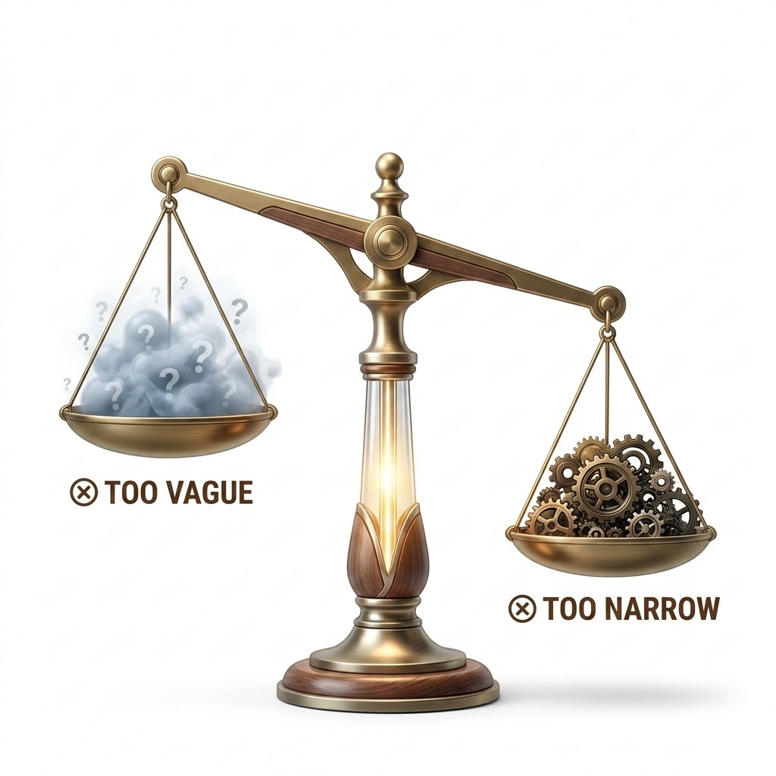
Asking a Good Question
Same data, different questions
Too Vague: Are facial analysis systems biased?
Too Narrow: Does an image receive one incorrect label from one system?
Alternate options:
In what ways do market-leading gender recognition tools exhibit disparate accuracy rates when evaluated at the intersection of skin color and gender expression?
How do commercial gender classification systems perform across intersectional groups defined by perceived gender presentation and skin tone?

Slide 6
What makes a question ‘good’?
Empirical
Falsifiable
Ask something about the world
Can be answered with evidence
Focused/Tangible
Important
Can be answered within our project
Answers a problem/challenge of significance
Sample Question
Do the algorithmic risk scores in the COMPAS dataset demonstrate higher false positive rates for Black defendants compared to White defendants?
Notes:
“How do commercial gender classification systems vary in error rate across intersectional groups?” is empirical because it can be tested with system outputs; falsifiable because the error rates may or may not differ; focused because it specifies a task and comparison; and important because the results affect accountability, representation, and downstream use of facial analysis systems.”

Slide 7
Why ask good questions?
Good questions prompt knowledge exploration that:
Is grounded in prior knowledge
Prevents starting with data alone
Clarifies what we want to know
Helps define and scope the project
Guides what data to collect
Encourages early ethical/critical thinking

Slide 8
What a good question can look like…
“We know women often face discrimination, but what happens when coders are anonymous on GitHub: Do women still face discrimination?
“We know human judges can be biased: Does the COMPAS algorithm reduce this bias, or does it simply hide existing racial disparities under a 'neutral' score?”

Slide 9






Reflection, Improvement, and Iteration
Ask
Is this the best way to answer the question?
Anticipate
How patterns change and opportunities to iterate
Observe
What is the data telling me?
PROBLEM SCOPING CYCLE
Read
Reflect on feedback and research to improve
Analyze
What patterns or insights can we derive?

Slide 10

Activity 1
In groups, examine the variables in the COMPAS 2013-2014 dataset:
Protected Attributes: Identify which columns are "protected attributes" (e.g., sex, race) and why their inclusion is controversial.
Missing Information: What contextual information about a defendant’s life (e.g., employment, family support, neighborhood quality) is missing from this table?
Stakeholder Harms: How might the two_year_recid prediction influence a judge's decision, and who bears the harm of a "False Positive"?
Research Limits: How do the limitations of this dataset influence the types of questions you cannot answer with numbers alone?
COMPAS Dataset
https://mlr3fairness.mlr-org.com/reference/compas.html

Slide 11
Activity 1
Column Name | Data Dictionary | HCDS Note
sex / race | Demographic identifiers. | Used to check for disparate impact.
priors_count | Number of previous arrests. | Does this reflect behavior or over-policing?.
score_text | Model Output: Risk category. | How does this label change a judge's perception?.
This dataset contains 6,172 observations of defendants.
COMPAS Dataset
https://mlr3fairness.mlr-org.com/reference/compas.html

Slide 12
Activity 1: From Technical to Human-Centered Framing
Follow these steps to move from "calculating accuracy" to understanding "social facts" in the COMPAS recidivism dataset.
Step 1
Step 2
What are the raw columns, and what is the machine trying to predict or measure?
What real-world context or human stories were stripped away to turn this life into a spreadsheet row?
Step 3
Step 4
Whose goals drive this project, and who bears the real-world burden when the model makes a mistake?
How does starting with a human-centered question change your data analysis compared to just starting with a raw dataset?

Slide 13



Ethical Practices
Considering the impacts of our work
Data science work has the potential to harm people. Ethics should be reflexive, considered at every step:
What could go wrong?
Who could be harmed?
Who could
benefit?
A model intended to neutrally assess ”risk” can inherit historical societal biases, mistaking over-policed neighborhood data for actual criminal intent.
Black defendants, who are statistically flagged with disproportionately higher false positive rates (wrongly labeled "high risk") compared to White defendants.
Institutional legal systems looking for automated efficiency, and commercial software vendors operating proprietary "black box" prediction models.

Slide 14
Belmont Report [1]
Human subject research conducted in the US and Canada follows guidelines from The Belmont Report, which outlines three core ethical principles:
Justice
Respect for Persons
Beneficence
Ethics is not only IRB/REB compliance. A data science project can be legally approved and technically reproducible while still being poorly framed from a human-centered perspective.

Slide 15
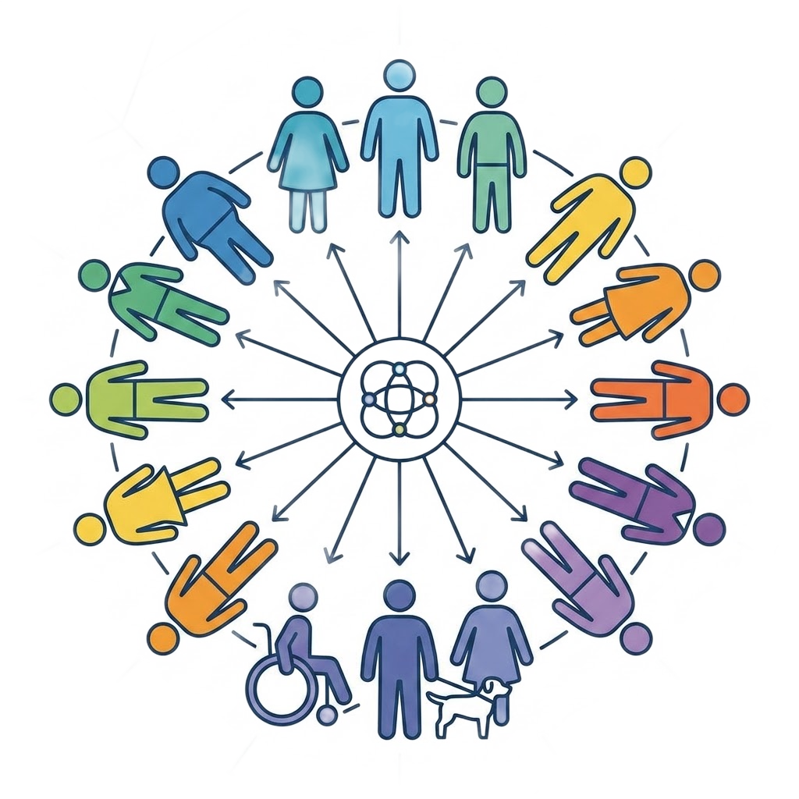
Justice
The Justice principle means that the benefits of research should be distributed fairly across society.
Research should ensure:
No group should bear an undue or unfair burden
Any group who could benefit or be harmed are included in research design
COMPAS Case: Black defendants disproportionately bore the burden of the model's errors, facing a false positive rate twice as high as White defendants (wrongly flagged as high-risk).
COMPAS Case: The downstream stakeholders—defendants, defense lawyers, and community advocates—were excluded from the algorithm's design process.

Slide 16
Respect for Persons
The principle of Respect for Persons means that participants should be fully informed and free to decide whether they participate in research.
Research should respect people’s rights to:
Autonomy
Privacy
Informed Consent
The right to make informed decision
Protecting personal data and privacy
Full transparency about the research process
Defendants lacked the autonomy to contest or opt-out of how their risk scores were generated or interpreted during sentencing decisions.
Standard criminal records and demographic inputs were aggregated into a proprietary profile without clear transparency regarding data retention or individual privacy rights.
Defendants did not give informed consent for their personal data to be processed by a commercial third-party algorithm to determine their legal outcomes.

Slide 17
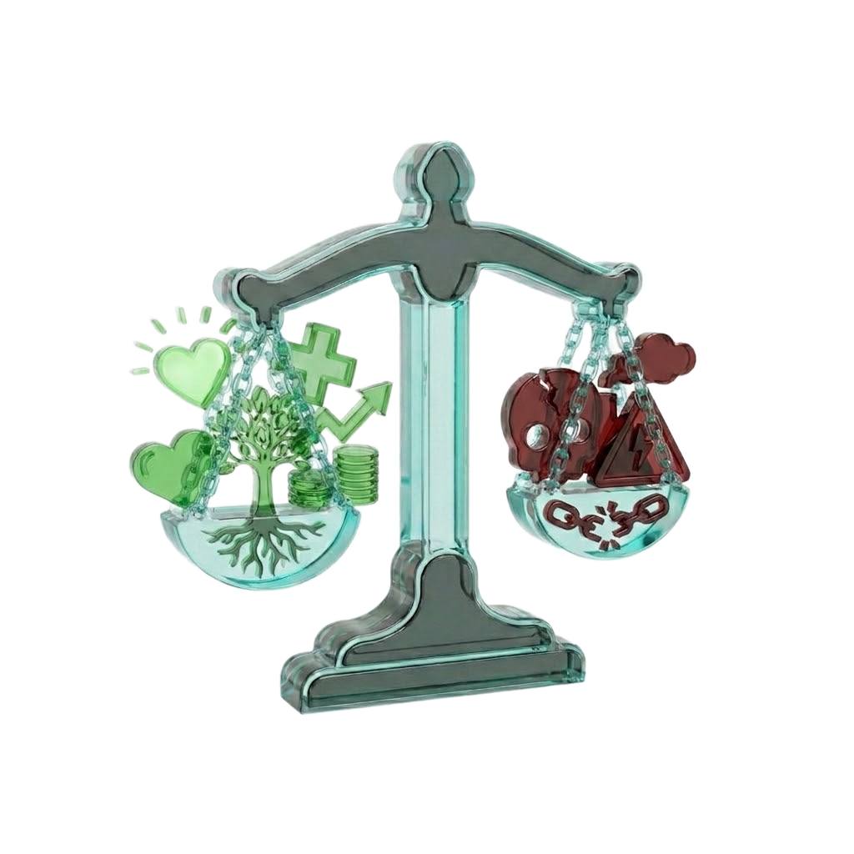
Beneficence
The principle of beneficence means that researchers must always work to ensure the greatest possible benefits to society while reducing risks and harm to participants.
Research should:
Minimize harm to participants
Maximize benefits where possible
The system failed to minimize harm because its training loop prioritized institutional classification speed over checking for disparate impact on marginalized defendants.
While the tool sought to maximize administrative efficiency and objectivity for the courts, it did not provide balancing benefits (like rehabilitation resources) to the individuals being evaluated.
Are both always possible?

Slide 18
Ethics of Representation
Data & results can be represented many ways:
Data representation tells a story about data science, the dataset, and the model
Framing Effect: How we define categories, metrics, and visualizations shapes what audiences think the problem is
Results should be shared by striving for transparency and accountability and by avoiding oversimplification
Iterative process that can lead to new questions
Combining Both!
Ethics + asking the right questions!
Prevents unnecessary data collection (Data Minimization)
Limits unnecessary risks/harm
Limits re-identification or loss of privacy [2]

Slide 19
Resources & Ethics Boards
In academic settings, ethical research is regulated by Institutional Review Boards (IRB) or Research Ethics Boards (REB). However, an institutional ethics review is only one part of responsible research.
True human-centered problem framing also requires actively reflecting on stakeholders, potential harms, missing data, and long-term downstream use. Beyond standard compliance, excellent resources and frameworks can be found across higher education, government, and professional training organizations:
Academic
Government
Training
Start with resources at your academic institution
Look at government resources
Look for possible trainings

Slide 20

Activity 2
Reflect on the COMPAS research question you crafted in Activity 1. Now, imagine you are moving from tabular criminal justice records to a massive computer vision dataset like FairFace or YFCC-100m to look at bias in a different domain.
Iterate and revise your understanding of a 'good question' after considering:
Consent & Sourcing: These facial images were scraped from public platforms. Even if an institutional review board (IRB/REB) legally clears public data, what are the ethical implications of using people's faces without explicit consent?
Missing Data & Classification Harm: How do the predefined categorical labels in the dataset (e.g., race, age, binary gender) oversimplify human identity? Who is erased or misrepresented by these technical choices?
The RA Dilemma (Downstream Harm): As a Research Assistant, if you discover that analyzing this data could inherently reinforce surveillance biases or systemic inequalities, would you choose to work on this project? How must you rewrite your research scope to minimize this harm?
FairFace Dataset
https://huggingface.co/datasets/HuggingFaceM4/FairFace

Slide 21
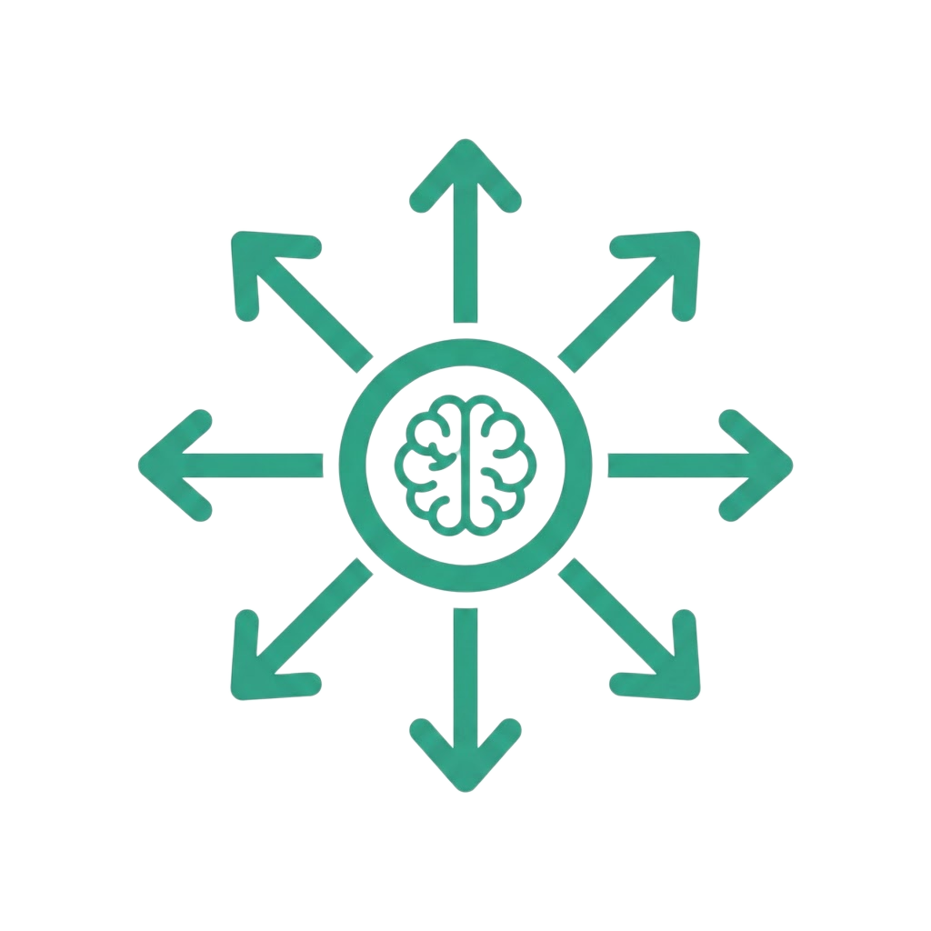
Generalizability
How others will use your project
Who might reuse your data,
Model, or pipeline?
How might they reuse it?
Who can reuse it and who can’t?
What would they need to reuse your data, model, or pipeline?
If a model is trained on the FairFace benchmark to achieve "balanced skin tone accuracy," can a healthcare lab reuse that pipeline to detect skin cancer equitably?

Slide 22
Generalizability
How others will use your project
General Generalizability Framework | FairFace / Computer Vision Application
Who might reuse your data, model, or pipeline? | Commercial developers, academic researchers, or healthcare labs looking for pre-trained facial analysis pipelines.
How might they reuse it? | Transferring a model trained on web-scraped data (FairFace) to perform tasks like facial authentication or medical skin anomaly detection.
Who can reuse it and who can't? | Well-funded teams can easily reuse the technical pipeline, but marginalized communities lack the resources to contest how the reused models categorize them.
What is required for case transfer? | A deep evaluation of whether a web-scraped categorization scheme safely applies to completely different global populations, lighting conditions, or contexts.

Slide 23
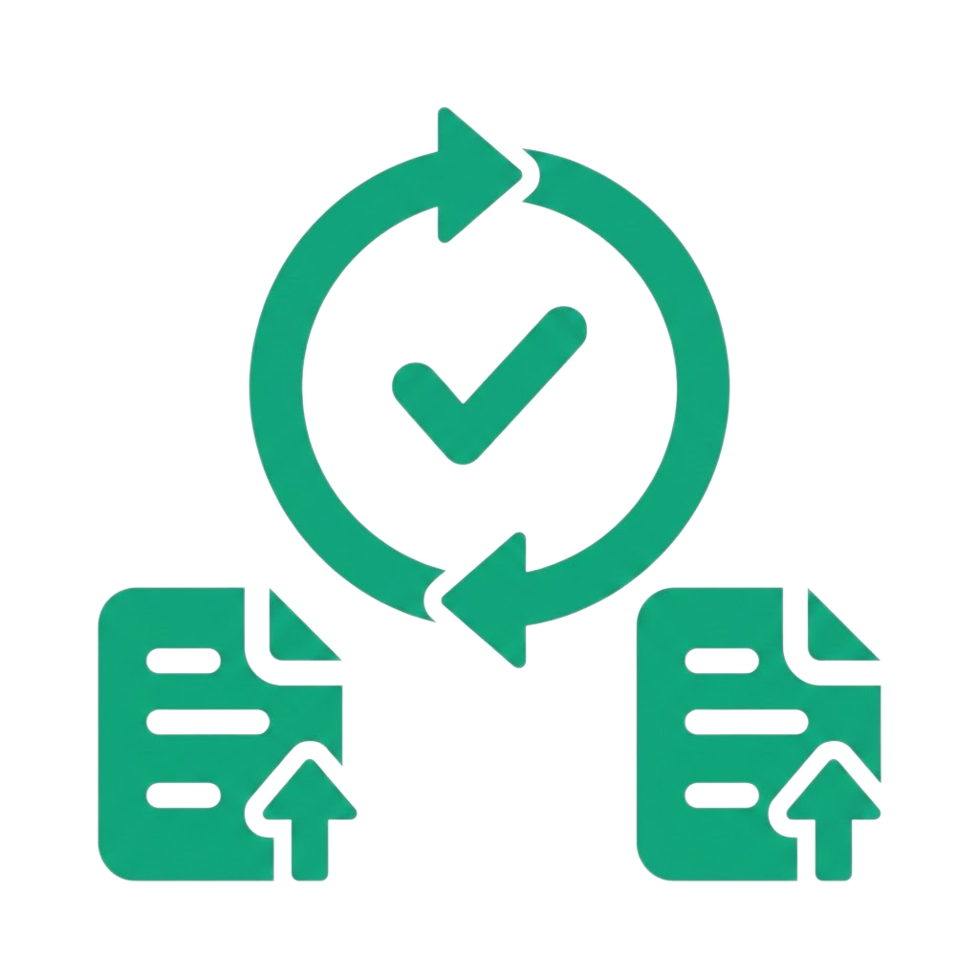
Reproducibility
Designing projects so others can verify the results by using the same methods
Clear, documented processes so others can reproduce your work
Ensure reliability and credibility of your findings
Clear decision logs and comments in code
GitHub or publication of your process

Slide 24
Reproducibility
Designing projects so others can verify the results by using the same methods
General Reproducibility Checklist | FairFace Checklist
Dataset & Model Access | Document the specific Hugging Face repository commit hash and source image resolution.
Variable Definitions | Explicitly define how "perceived race" and "perceived gender" are labeled in the data attributes.
Classification Task | Define the exact machine learning task (e.g., multi-class facial attribute classification).
Performance Metrics | Track per-class error rates and intersectional confusion matrices, not just overall accuracy.
Decision & Subgroup Log | Save a decision log detailing why certain outlier images or ambiguous labels were included/excluded.

Slide 25

Accessibility & Inclusivity
Consider who may be excluded from your work
Are visualizations accessible to those with vision impairments? Are you intentionally excluding people with disabilities from interacting with your work?
Are you promoting true inclusivity, or are your visuals collapsing complex identities into limited or restrictive categories?
Look for local and federal governmental resources
In Ontario, AODA: https://www.aoda.ca/implementing-federal-standards-for-accessibility-in-information-and-technology/

Slide 26
Accessibility & Inclusivity
Consider who may be excluded from your work
Design & Presentation Accessibility | Framing & Categorical Inclusivity
Visual Accessibility Are model performance charts, confusion matrices, and data plots legible to individuals with vision impairments or color blindness? | Identity Collapsing Does the project's technical framing force complex, fluid human identities into rigid, limited categories (e.g., binary gender or fixed racial buckets)?
Platform Compatibility Are digital artifacts, code notebooks, and portfolio websites optimized for screen readers and assistive technologies? | Exclusion Harm Who is systemically erased, misclassified, or placed in danger when an automated system simplifies human social dimensions to streamline a training loop?
Regulatory Compliance Utilizing local and federal frameworks (like Ontario's AODA) to ensure technical deliverables meet public accessibility standards. | HCDS Critical Practice Actively interrogating whose perspectives shaped the dataset's categories, and rewriting the research question to minimize classification harms.

Slide 27

Openness
Consider the balance between sharing data and respecting privacy
Can you share your results and your processes?
Balance between openness and privacy
Are there regulations or data ownership issues that prevent sharing your result?

Slide 28
Openness
Consider the balance between sharing data and respecting privacy
General Openness Framework | FairFace / Computer Vision Application
Can you share your results & your processes? | Sharing aggregated accuracy metrics and open-source auditing code on GitHub is highly valuable for scientific transparency.
Balance between openness and privacy | The Conflict: Full data release is valuable, but republishing scraped images of real people creates severe privacy, consent, or downstream misuse concerns.
Are there regulations or data ownership issues? | Copyright, terms of service restrictions from the original platforms, or regional privacy laws may legally restrict you from distributing the raw image files.
Responsible Data Stewardship | Students must learn that open science principles sometimes directly conflict with the ethical duty to protect vulnerable subjects from data re-use.

Slide 29
Activity 3: Group Exit Ticket
Your group has been asked to design a responsible replication or extension of the Gender Shades study using the FairFace dataset. Based on your work in this module, prepare a short scoping memo that answers:
Research Question Evolution: What is your final research question, and how did it change from your first technical version?
Data & Stewardship: What data do you need from FairFace, and what data should you avoid collecting based on your Activity 2 ethical audit?
Metrics & Representation: What specific subgroup comparisons and fairness metrics will you report? Who is still missing or collapsed in these categories?
Openness & Reproducibility: What will you document in your decision log so another team can reproduce, critique, or safely transfer your workflow?

Slide 30
Institutional Review
Start with resources at your academic institution
Other good academic resources are:
https://doresearch.stanford.edu/who-we-are/responsible-and-ethical-conduct-research-education
https://jhura.jhu.edu/compliance-2/human-subjects/
Government Guidance
Look at government resources;
US: Health and Human Services (HHS): https://www.hhs.gov/ohrp/sites/default/files/educational-resources-for-irb-members.pdf
National Institutes of Health (NIH): https://www.nih.gov/health-information/nih-clinical-research-trials-you/guiding-principles-ethical-research
National Science Foundation (NSF): https://www.nsf.gov/funding/research-involving-human-subjects
Canada: Tri-Council Policy Statement: Ethical Conduct for Research Involving Humans (TCPS2):https://tcps2core.ca/welcome
Ethics Training
Look for possible trainings such as CITI Program
https://about.citiprogram.org/get-to-know-citi-program/

Slide 31
Credits and References
National Commission for the Protection of Human Subjects of Biomedical and Behavioral Research. (1979). The Belmont report: Ethical principles and guidelines for the protection of human subjects of research. U.S. Department of Health and Human Services. https://www.hhs.gov/ohrp/regulations-and-policy/belmont-report/read-the-belmont-report/index.html
Eliazar, A., Brown, J. T., Cinamon, S., Kantarcioglu, M., & Malin, B. (2026). Re-identification risk for common privacy preserving patient matching strategies when shared with de-identified demographics. Journal of the American Medical Informatics Association : JAMIA, 33(2), 336–346. https://doi.org/10.1093/jamia/ocaf183
Buolamwini, J. & Gebru, T. (2018). Gender Shades: Intersectional Accuracy Disparities in Commercial Gender Classification. Proceedings of the 1st Conference on Fairness, Accountability and Transparency, in Proceedings of Machine Learning Research 81:77-91 Available from https://proceedings.mlr.press/v81/buolamwini18a.html
Karkkainen, K., & Joo, J. (2021). FairFace: Face Attribute Dataset for Balanced Race, Gender, and Age for Bias Measurement and Mitigation. Hugging Face Datasets / IEEE Winter Conference on Applications of Computer Vision (WACV). https://huggingface.co/datasets/HuggingFaceM4/FairFace
Pfisterer, F., Wei, S., & Lang, M. (2026). COMPAS Dataset [Data file and code artifact]. In mlr3fairness: Fairness Auditing and Bias Mitigation. https://mlr3fairness.mlr-org.com/reference/compas.html
COMPAS/ProPublica: https://www.propublica.org/article/how-we-analyzed-the-compas-recidivism-algorithm

